Slide 1

In The Name Of ALLAH, The Most Beneficent, The Most Merciful

Slide 2

IP Controlled Robot Receptionist Through Raspberry Pi
A Final Year Project
Supervised
by
Assistant Professor
Dr. S.M Riaz Hussien
Department Of Electrical Engineering
CIIT Islamabad

Slide 3
IP Controlled Robot Receptionist/guide Through Raspberry Pi
Team Members
Mina Khan (FA12-BCE-051/ISB)
Muhammad Bilal Jamil (FA12-BCE-007/ISB)

Slide 4
Contents
Introduction
Motivation
State Flow Diagram
Milestones achieved
Available Robots vs. Robot receptionist
Future Enhancements
Selection Of Board/Controller?
Goals/ achievements
Block diagram

Slide 5
Introduction
Building an autonomous robot using Raspberry Pi which will act as a receptionist to guide people from one destination to another
Application of this robot is a hotel receptionist or an office attendant

Slide 6
Motivation
Introduction of robotics into the environment making it more Hi-tech.
Economical advantage to the company/institute that uses the robot
With the help of Raspberry Pi, huge visions could be implemented without exceeding the budget
In Pakistan, no major work with a step towards copping up with the highly advanced world of technology

Slide 7
Selection Of Board/Controller?
Raspberry pi
Arduino
It is an on-board computer.
Can run operating system.
Best for projects that require more interactivity and processing power.
More complex.
Possibility of threading
It is a micro-controller.
Cannot run operating system.
Best for electronics related projects.
Less complex.
Threading is not possible

Slide 8
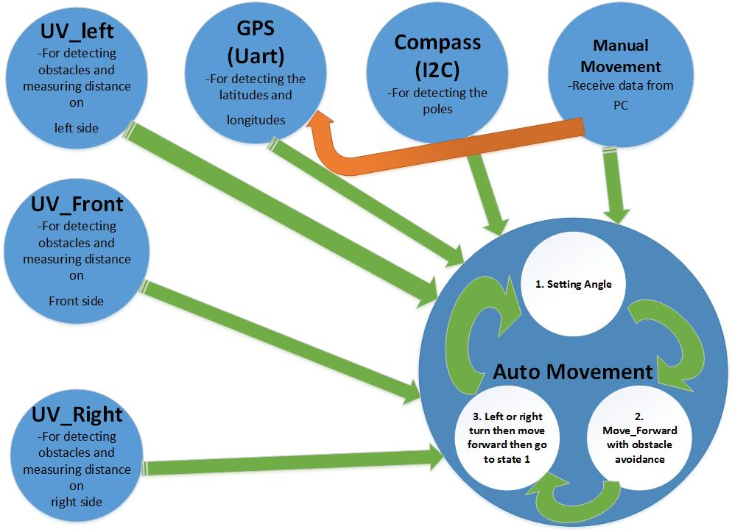
State Flow Diagram

Slide 9
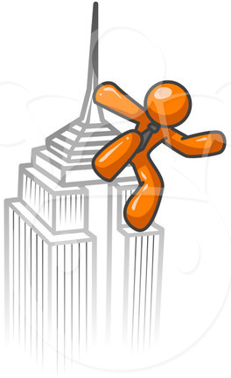
Milestones achieved
Hardware Assembly
Selection Of Board/Controller?
User Interface Of Raspberry Pi with PC
Wi-Fi Interference
Obstacle Detection and avoidance mechanism
Pre-defined Path Followed

Slide 10
continued….
GPS Interfacing
Wireless Connectivity Achieved
Autonomous & Manual Control
Graphical User Interface

Slide 11
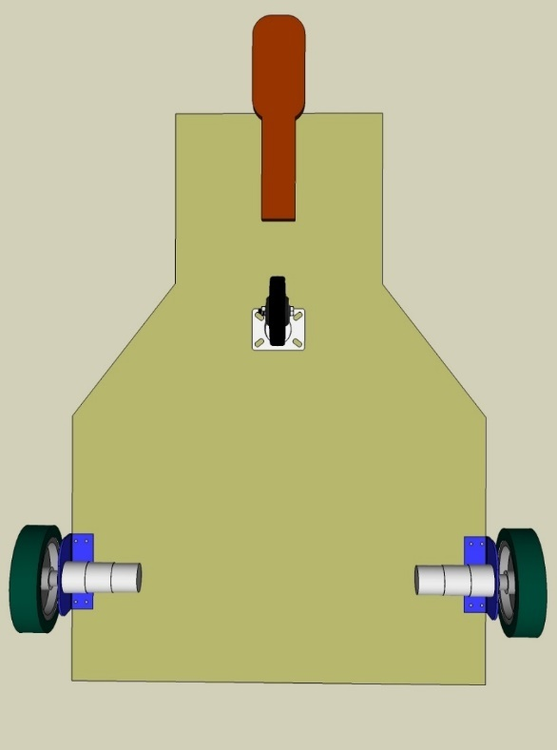
Robotic Body…

Slide 12
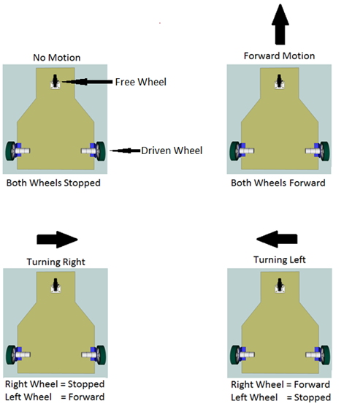

Slide 13
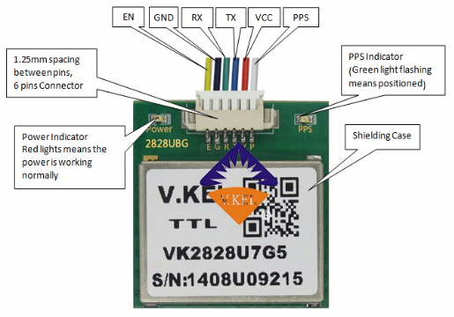
GPS Interfacing
Pins’ Definition:
Notes:
PPS
Output time pulses (pulses per second)
Power Enable: high level means the module works, low level means the modules is closed.

Slide 14
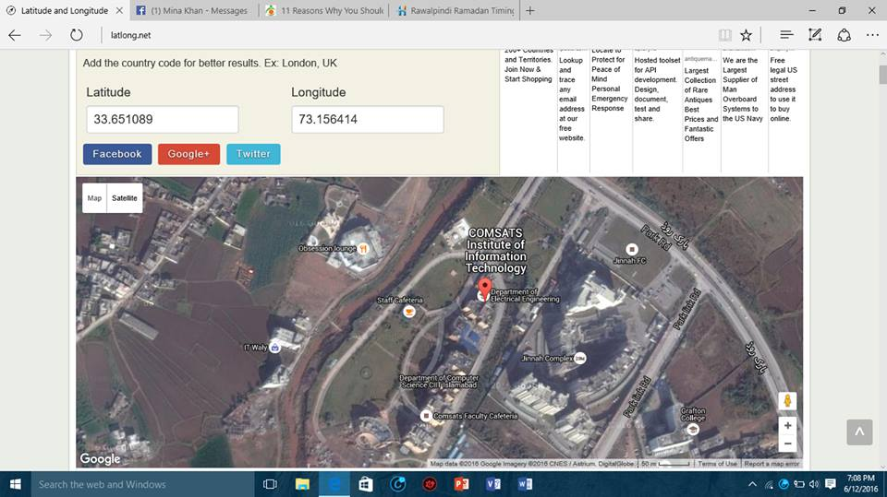
Latitude & Longitude Of EE dept

Slide 15
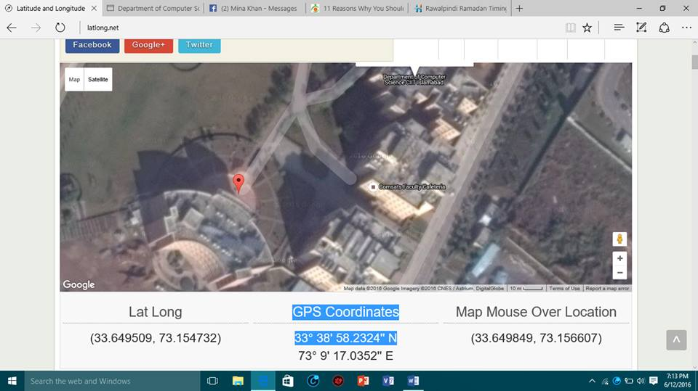
Latitude & Longitude Of Library

Slide 16
GPS Coordinates Conversion
lat1 = ( float(lat_one) + float(lat_two)/60 )
lon1 = (float(lng_one) + float(lng_two)/60)

Slide 17
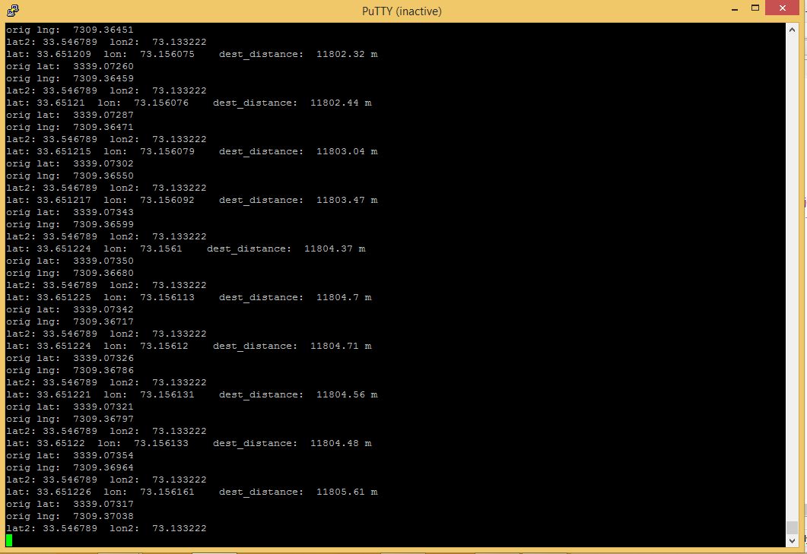
Latitudes & Longitudes In Lxterminal

Slide 18
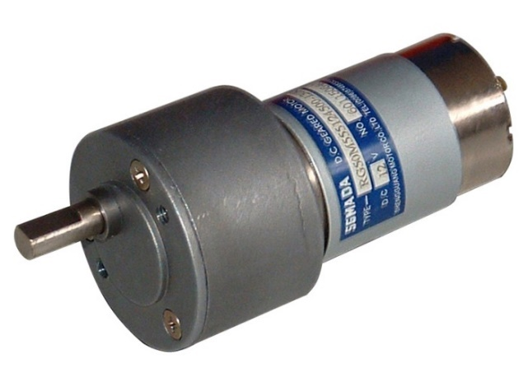
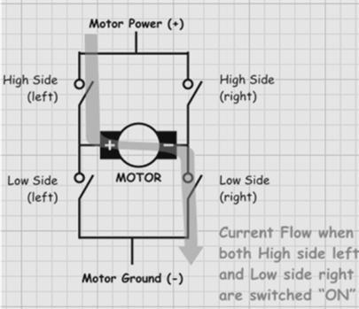
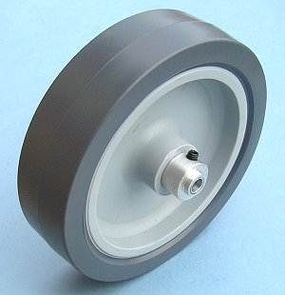
Movement Mechanism
H-Bridge

Slide 19
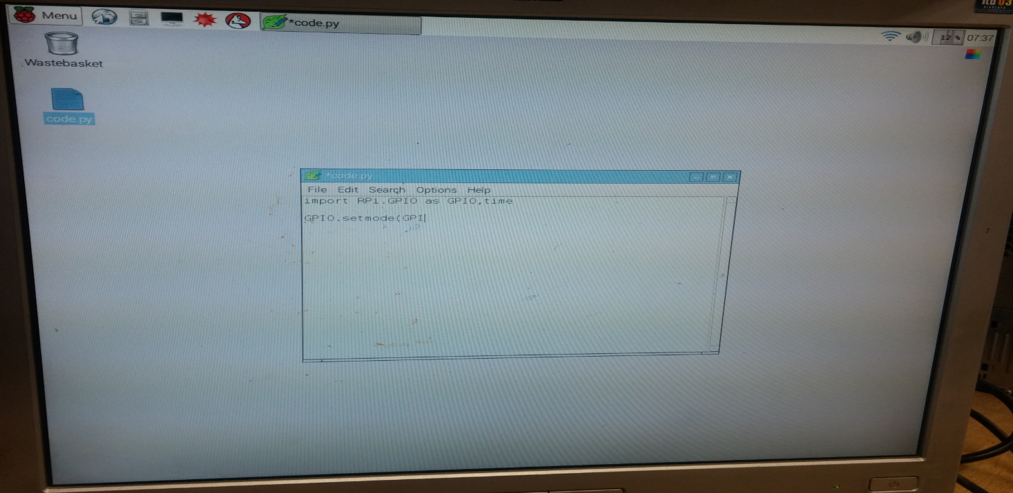
User Interface Of Raspberry Pi with PC
Raspbian GUI

Slide 20

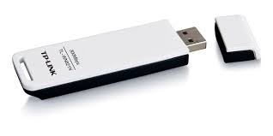

Wi-Fi Interference

Slide 21
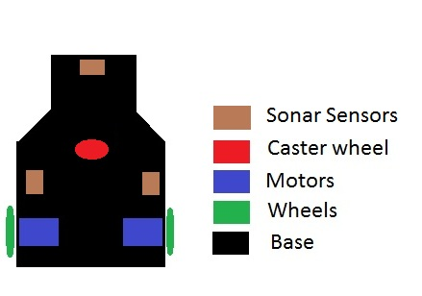
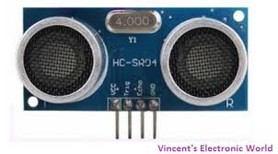
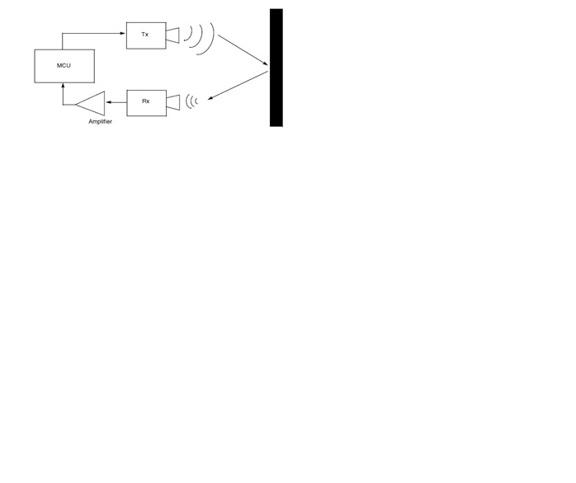
Obstacle Detection and avoidance mechanism
Static obstacles
Dynamic obstacles

Slide 22
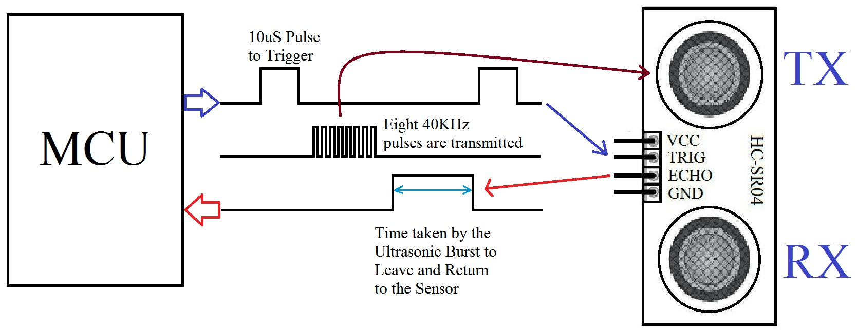
Obstacle Detection and avoidance mechanism

Slide 23
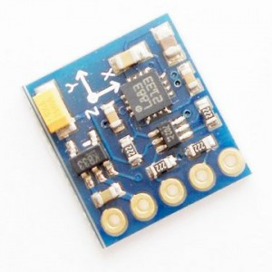
Compass Usage
Calculation Of Angles
Estimation Of Distance from Source To Destination
Keep Moving Towards the destination
Guiding the Robot To Set the head

Slide 24
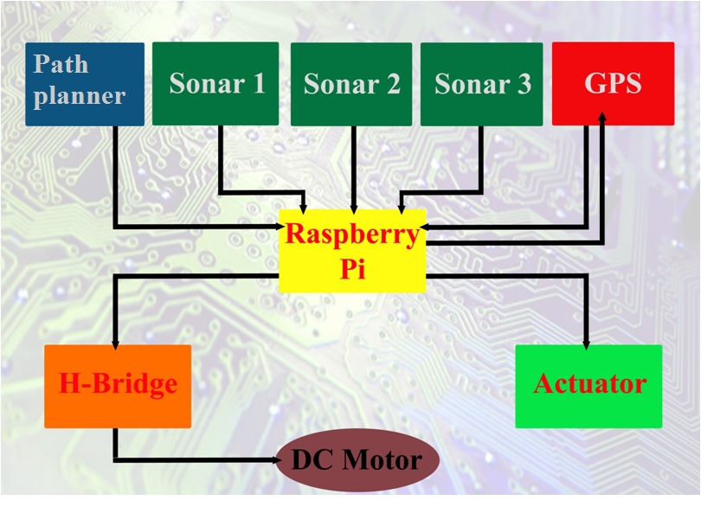
Block Diagram

Slide 25
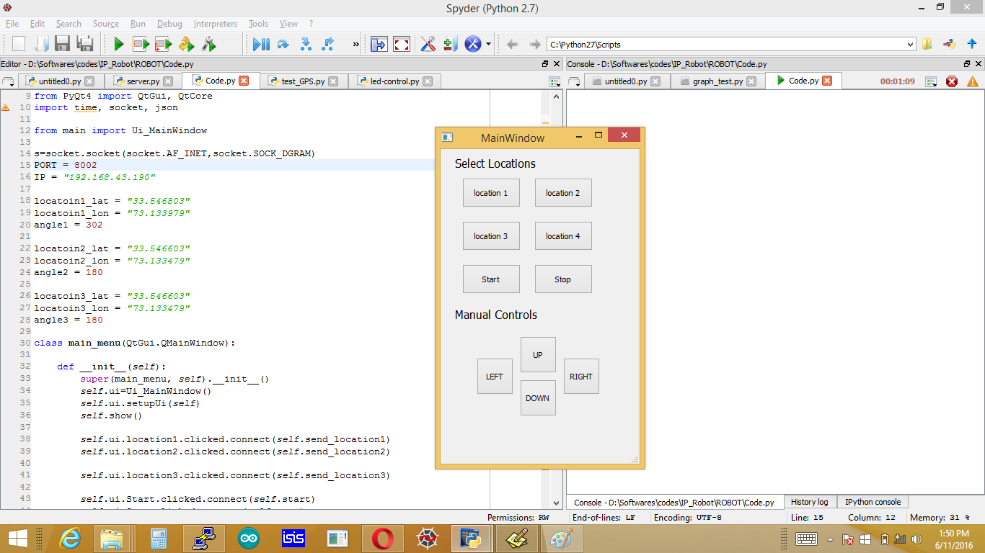
Graphical User Interface

Slide 26
Authentication Access
The Guest will be assigned the correct IP address of raspberry pi so that he/she can access the robot.
Along with IP address the guest will also be assigned a specific port number which will grant the access completely.
Without these two one cannot control and access the IP Controlled Robot At all.

Slide 27
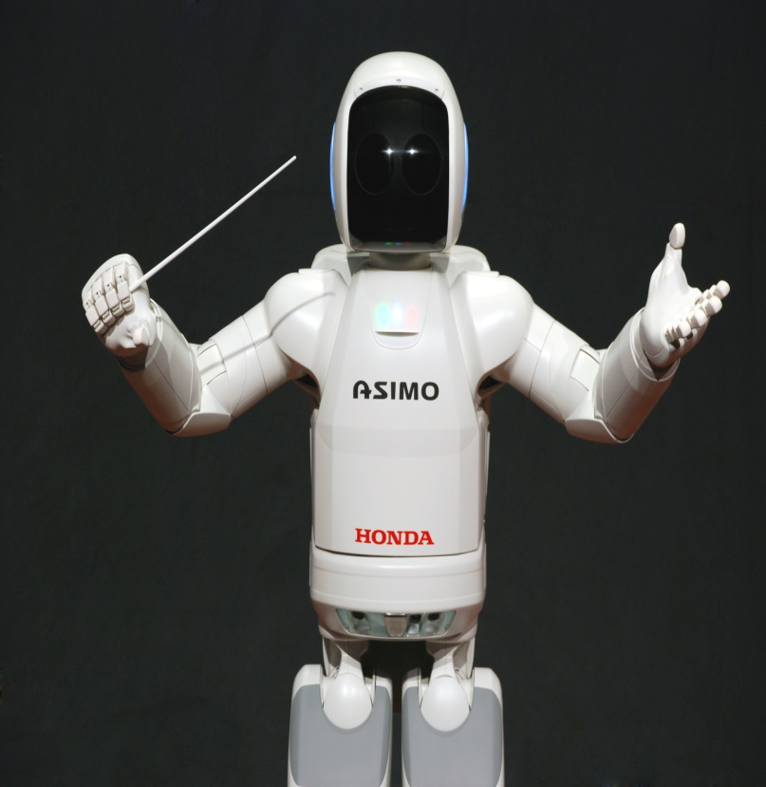
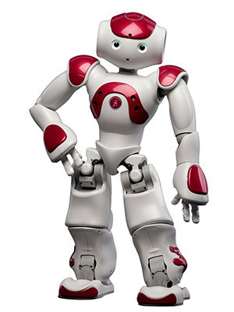
Available Robots vs Robot Receptionist

Slide 28
Available Robots vs. Robot receptionist
The cost of present robots is about 70,0000 PKR
IP controlled robot cost us about 30,000 PKR due to research work and implementation
Bulk production will reduce cost further and cost effective procedures are applied
Like this robot, Not all robots are open source
Can be used in daily life due to it’s size and price

Slide 29
Accomplishments
Learned Python, A totally new object oriented programming
Fully understood the functionality and purpose of a Rasbperry Pi
Gained experience in robotics
Learned how to make a graphical user interface
Unlocking the true potential of multi-processing with the help of raspberry pi

Slide 30
Problems Faced
Due to low budget we could not buy good components for better flexibility of robot
GPS latency issues i.e a normal gps requires data from at least from 6 satellites
Cheap gps doesn’t have a strong antenna which causes problems when calculating the latitudes and longitudes
Operating system of raspberry pi is unstable
Less distance range of sonar sensors i.e 70cm

Slide 31
Future Enhancements
Digital camera for vision
Face Detection for more security
Path Planning & Strategy
Mine Detection
Bomb Defusal

Slide 32
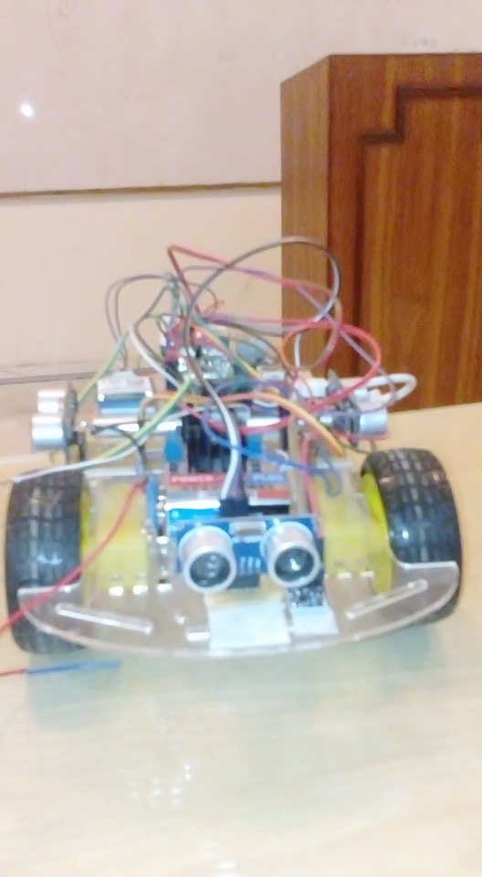
Final Prototype

Slide 33

Thank you!

